Slide 1
Lab 1 Q5
Chong Wen Jie Vincent - 7223766
Sally - 4603229
Chng Wei Da Amos - 7224126

Slide 2
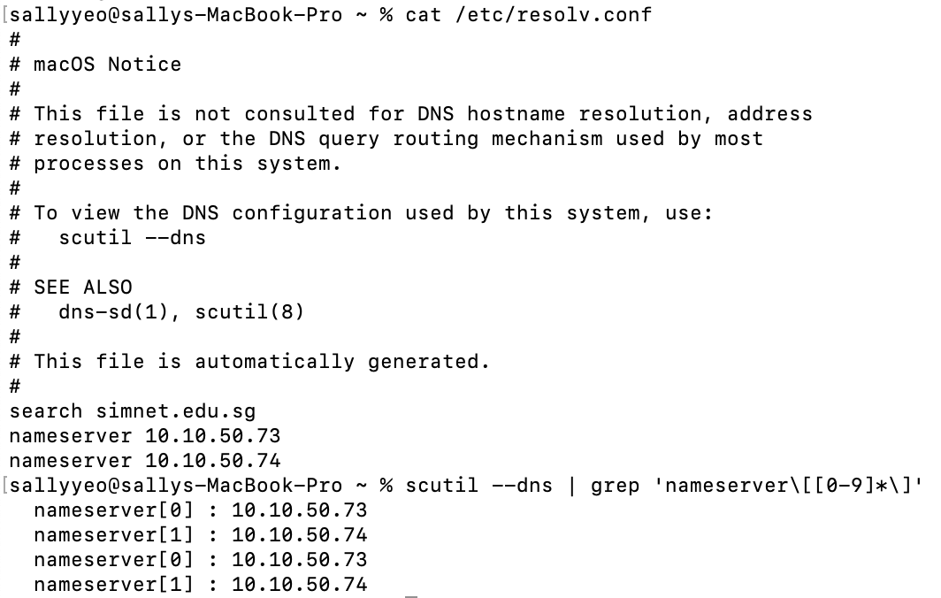
IP addresses of our local DNS server (resolver)
Sally’s local DNS server (resolver)

Slide 3
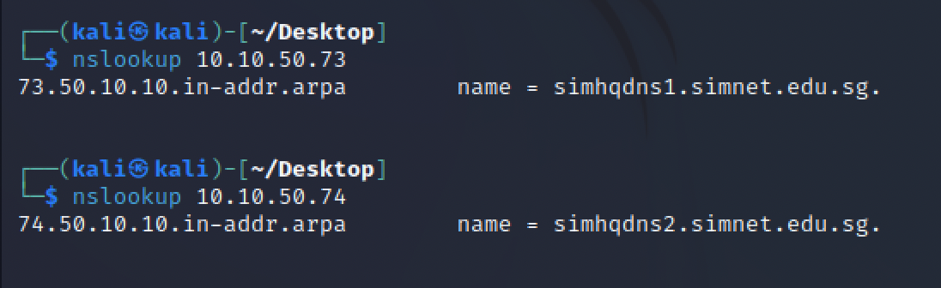
IP addresses of our local DNS server (resolver)

Slide 4
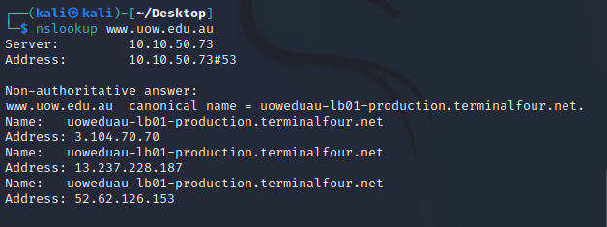
IP address of www.uow.edu.au
Addresses:
3.104.70.70 + 13.237.228.187 + 52.62.126.153

Slide 5
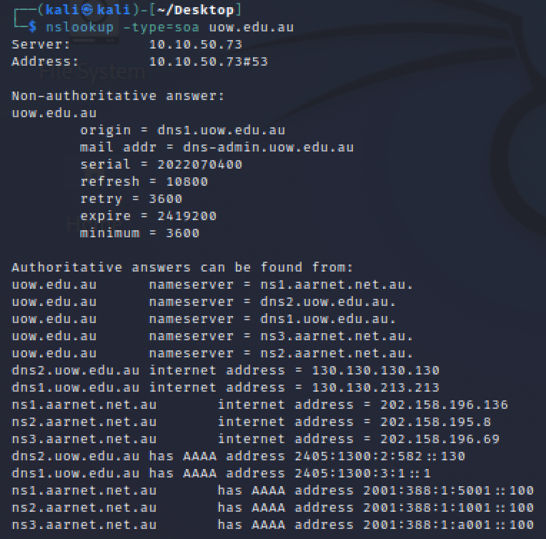
Name of primary authoritative DNS server of www.uow.edu.au

Slide 6
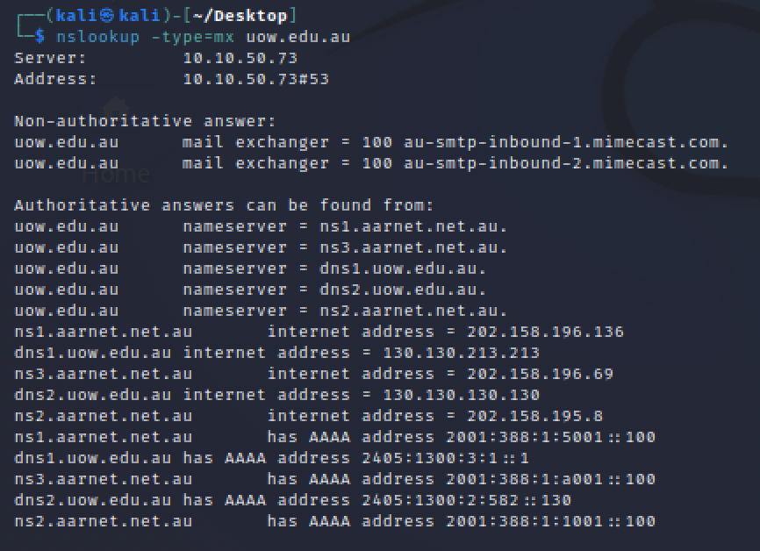
Name of the mail server of our uow domain (uow.edu.au)

Slide 7
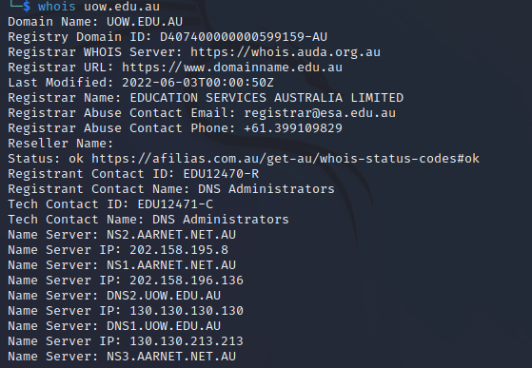
“Registrar Name” of www.uow.edu.au

